Slide 1



Gym website design
Project by
C. Madhu sudhan Naidu(192211226)
J. Tharun (192211251)
N. Chethan Reddy(192211207)
Guided by
Dr. K. Jayasakthi Velmurugan
Notes:
NOTE: To replace a picture, just select and delete it. Then use the Insert Picture icon to replace it with one of your own!

Slide 2

AIM:
In many Gyms, the payment receipts are in paper format. So it is very difficult for both gym members to keep all the paper receipts safely and to gym trainer to keep reminding for the fee receipts.
So, I am developing an application to overcome some of these issues. So this project can be helpful for both gym owner as well as for gym members.
In this application all receipts are store in a digital format, so there are no issues of losing any confidential receipts. This application will also notify the user (gym members) about their fees and also notifies the gym owner about the payment clearance.
This application can be elaborated by providing supplement store, diet information, personal training etc. every member handle the diet maintenance with once registration and also provide a personal training for each and every members.

Slide 3
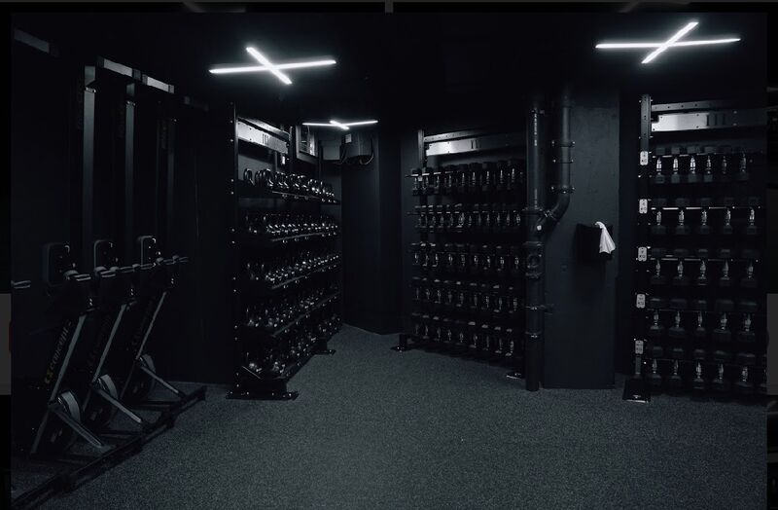
EXISTITING SYSTEM:
The gym is working manually. The current system is time consuming and also it is very costly, because it involves a lot of paperwork. To manually handle the system was very difficult task. But now-a-days computerization made easy to work. The following are the reasons why the current system should be computerized:
To increase efficiency with reduced cost.
To reduce the burden of paper work.
To save time management for recording details of each and every member and employee.
To generate required reports easily.

Slide 4

PROPOSED SYSTEM:
The proposed system is used for stores records of the system.
It is easier to find the user names, workout timings, summery etc.
Time table is orderly arranged. It has implemented an information of about the gym, about fees structure and schedule of workout days and also schedule of daily diet for every members.
Then, the gym was provided a supplement store for viewing what all specialties’ are of workout and diet. Gym admin can maintain the daily attendance and workout summery.
This application will also notify the user (gym members) about their fees and also notifies the gym owner about the payment clearance.

Slide 5


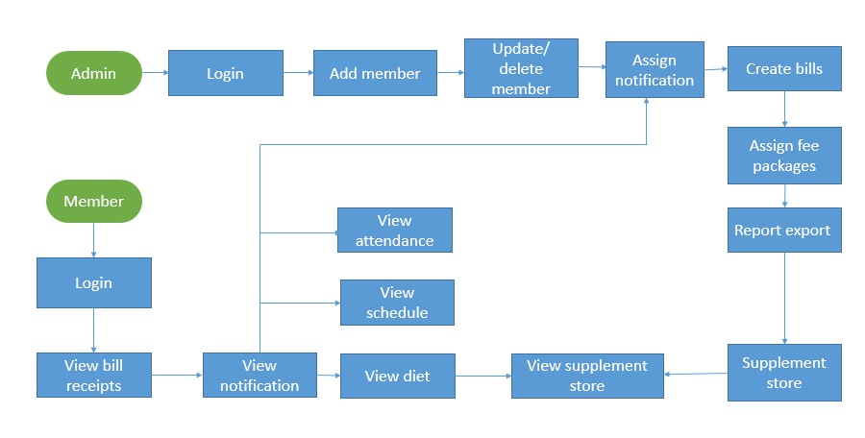
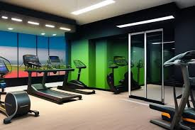
ARCHITECTURE DIAGRAM:

Slide 6

MODULES:
02
CASCADING STYLE SHEET(CSS)
03
JAVA SCRIPT(JS)
01
Hyper text markup language(html)

Slide 7
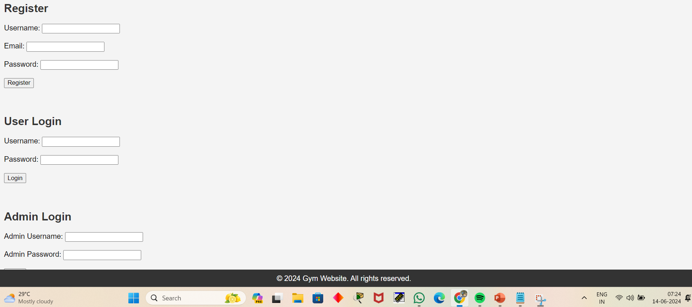
HTML:
Login interfaces for registration , user login and admin login.

Slide 8

CSS:
It controls the layout and appearance of web pages, allowing developers to separate content from design for more manageable and flexible web development.

Slide 9
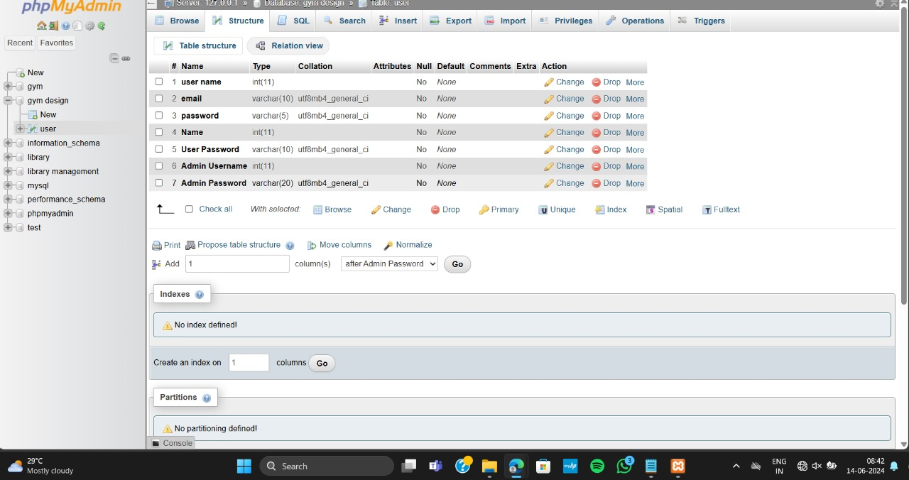
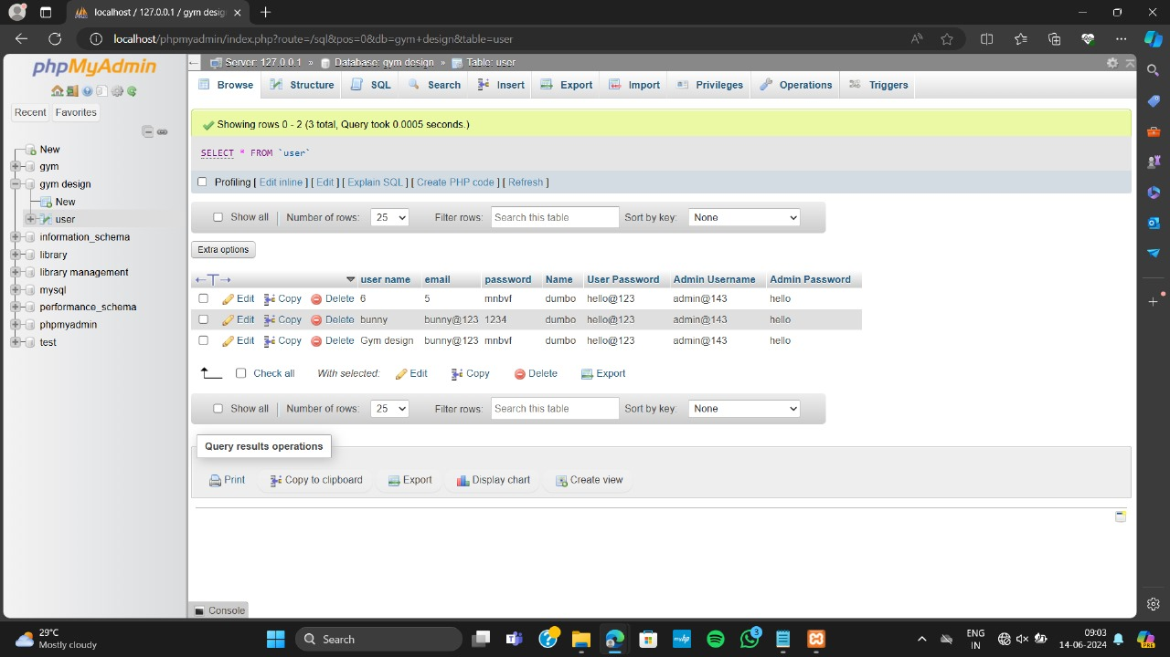
DATABASE CONNECTIVITY:
The database connectivity refers to the methods and processes used to connect a database to an application or system, allowing for data retrieval, manipulation, and storage. This is a crucial aspect of web development, enabling dynamic content and data-driven applications

Slide 10

CONCLUSION:
The “GYM Website Design” is successfully designed and developed to fulfilling the necessary requirements, as identified in the requirements analysis phase, such as the system is very much user friendly, form level validation and field level validation are performing very efficiently.
The new computerized system was found to be much faster and reliable and user friendly then the existing system, the system has been designed and developed step by step and tested successfully.
It eliminates the human error that are likely to creep in the kind of working in which a bulk quantity of data and calculations as to be processed.
The system results in quick retrieval of information that is very vital for the progress any organization. Cost is minimized in case of stationary.
Burden of manual work is reduced as whenever transaction takes place, there is a no need to record it in many places manually

Slide 11

References:
L. Morgado, J. Varajão, D. Coelho, C. Rodrigues, C. Sancin, V. Castello, “The Attributes And Advantages Of Virtual Worlds For Real World Training,” The Journal Of Virtual Worlds And Education, 1 (1), 2010.
F. Cassola, L. Morgado, F. De Carvalho, H. Paredes, B. Fonseca, And P.Martins, “Online-Gym: A 3d Virtual Gymnasium Using Kinect Interaction,” Procedia Technology, 13, Pp. 130-138, 2014
A Project Paper On Smart Gym Management System From Semantic Scholar By Monir Ahamed
A Smart Gym Framework: Theoretical Approach By Abhay Jain
Gym Management Interface By Sunil K Joseph, GeetuThomas,Prem Jose Vazhacharickal
Virtual Gym Management System By Manjiri R. Girnale, Komal D. Untwal, Sonali S. Jathar
Database And Transactions Management System For A Smart Gym: Layyah Fitness Center Muhammad Abdul Shakoor, Muhammad Abbas, Muhammad Irfan Mehdi, Sajjad Hussain, Ashraf A

Slide 12


Slide 13


